Slide 1
Fullstack (Web)Development

Slide 2
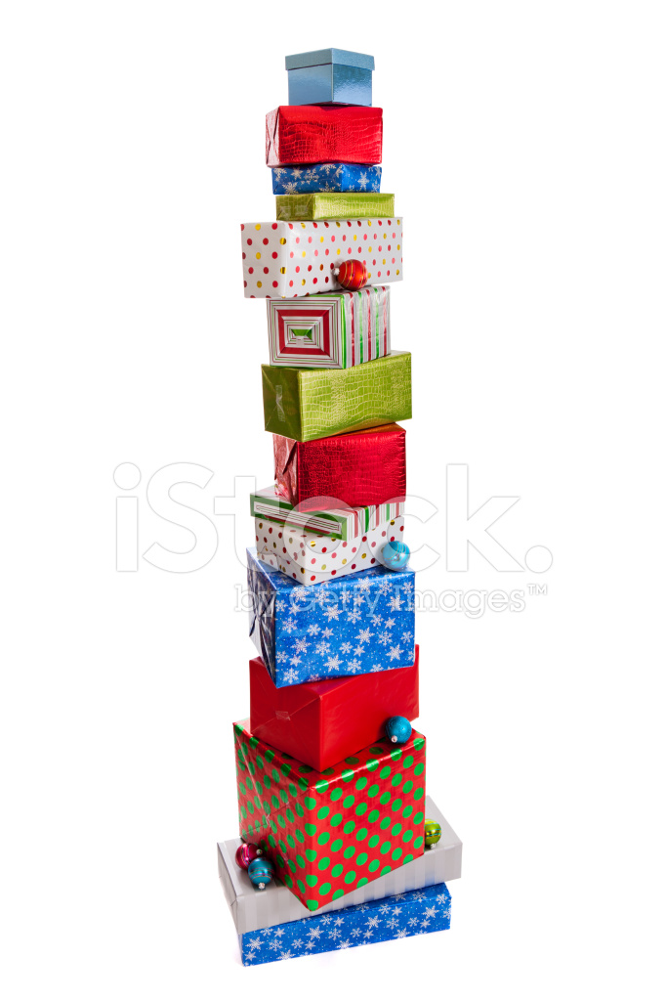

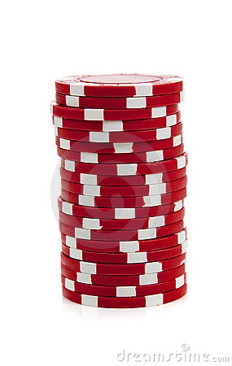
What is a stack?
Notes:
Tell me what you see…
Stack is a composite structure that is built with smaller structures that are placed one upon another.

Slide 3
A typical web application
Front End
Back End
Notes:
What is the front end of a Television? We can say as the remote, the various controls in the menu, volume up/down button..
What is the backend of the Television? Your LED panels, resistors and capacitors.
What is front end?
It is the part of the application that is visible and consumed by users. Or generally all the code that runs on the browser is the frontend. Additionally, its not just the code that runs, but also the tools that help the development of the front end code is added to the part of frontend.
What is backend?
Backend is the part of application, that enables the communication and storage with hardware. All the code that runs on the server is the backend.

Slide 4
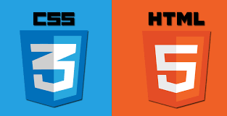




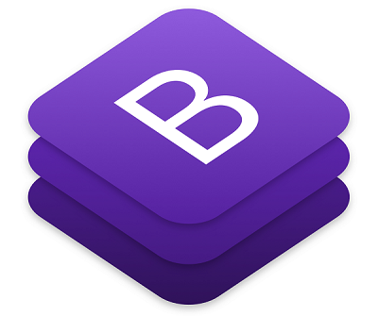








Slide 5

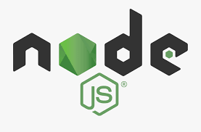












Slide 6


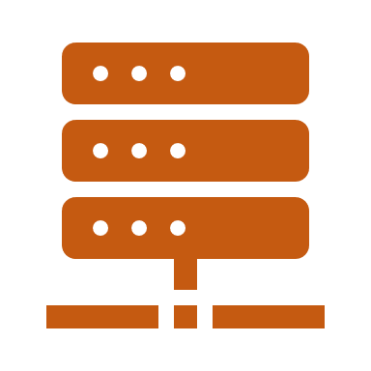
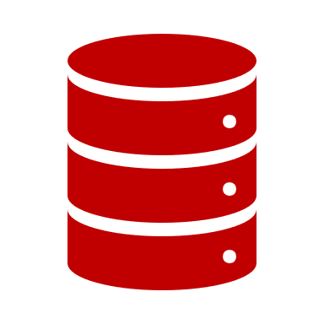
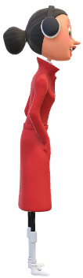
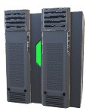

All about web application
1
2
5
3
4
8
7
6
Notes:
How does a web application work?
DNS resolution request for a domain.
DNS resolution response with the IP.
Web Request
Application Request
External request/responses
DB queries/responses
Application response
Web response

Slide 7
All about web application
Serves document from a centralized server.
Server is identified by a URI, which in turn maps to an IP address
Uses HTTP as the application level protocol, a stateless protocol.
Uses TCP as the underlying transport, a stateful protocol.
Renders output as HTML
Uses web browser for displaying the User Interface.

Slide 8
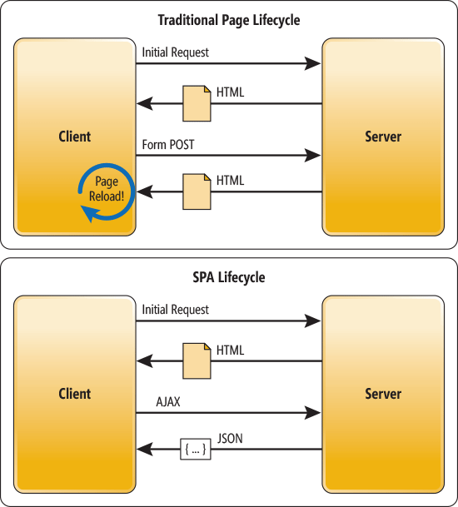
Traditional vs Single Page Web application
Notes:
Explain
AJAX
REST API

Slide 9
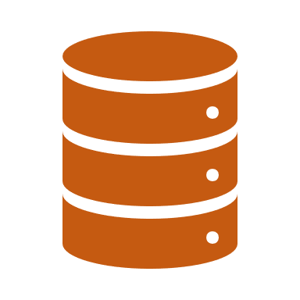
Front End
User Interface Layer[HTML/CSS/Javascript]
Validation and Business Logic Layer
Communication Layer
Back End
Communication Layer
Validation and Business Logic Layer
Persistence Layer

Slide 10
JARGON QUIZ

